Slide 1



Miss Ricardo

Slide 2

All About Miss Ricardo
My background:
  I am from Manalapan, New Jersey.
  I have one younger brother who just graduated college.
  I love hiking, going to the beach and making art.
  I am the first teacher in my family and the first person on my dad’s side to get a college degree.
My experience
  This will be my 3rd year teaching first grade at WHS school.
  Prior to WHS, I taught in Florence and Trenton.
I attended The College of New Jersey and received two bachelor’s degrees (One in Elementary Education K-6 and the other in Psychology)
  I work a second job during the summer as a Kindergarten Group Supervisor, for a summer camp. I just finished my 10th year there.

Slide 3

Dismissal
If your child is going to be dismissed in a different way than their normal scheduled routine, you must send in a handwritten note.
If you find out midday that their will be a change, you must call the office.

Slide 4
Lunch and Snack
Make sure your child knows if they are getting lunch and the choices that are available. You can find it on the Readington Website under the “Our District” tab. The heading is “Food Services”.
Send in a water bottle daily.
2 healthy snacks.

Slide 5

Homework
Monday-Thursday
Read for at least 10 minutes each day
Math Worksheet when given
Handwriting when given
Sight Word Practice as needed
Math Fact Practice as needed

Slide 6
Specials Schedule
Monday
Gym (Sneakers)
Tuesday
Spanish
Wednesday
Library (Return books)
Thursday
Gym (Sneakers)
Art
Friday
Music

Slide 7


Logging into Clever at Home

Slide 8

iReady Classroom Mathematics
Develops a classroom environment that promotes mathematical reasoning and discourse.
Unit 1: Relating Addition and Subtraction
Unit 2: Addition and Subtraction Within 20
Unit 3: Solving Word Problems and Making Comparisons
Unit 4: Using Tens and Ones to Organize and Count
Unit 5: Operations with Tens and Ones
Unit 6: Geometry and Measurement

Slide 9
i-Ready Diagnostic and Math Path
All About iReady Video
Diagnostics will be given in September, January, and June
The i-Ready Diagnostic is an adaptive assessment that adjusts its questions based on the child’s answers. The purpose of this is not to give your child a grade, but instead to determine how best to support your child’s learning.
The i-Ready Math Path provides students with individualized lessons based on their individual skill level and needs. It is determined by the iReady diagnostic. Your child can learn at a pace that is just right for them. These lessons are fun and interactive to keep your child engaged as they learn.

Slide 10

Reader’s and Writer’s Workshop
Writer’s Workshop
Small Moments
How to Books
Opinion Writing
Realistic Fiction
Nonfiction
Writer’s Projects
Poetry
Reader’s Workshop
Building Good Reading Habits
Nonfiction
Fluency, Phonics and Comprehension
Meeting Characters
Poetry, Fables, Fantasy Fiction, and Plays

Slide 11
Phonics
Units:
Talking and Thinking about Letters
The Mystery of Silent E
From Tip to Tail: Reading across Words
Word Builders: Using vowel teams to build big words
Marvelous Bloopers: Learning through wise mistakes
Phonics Projects

Slide 12

Social Studies
Units:
Our Special Location (Communities)
Families Near and Far (Responsibilities)
Civic Engagement (Rules and Laws)

Slide 13

Science
Units:
Light and Sound
Air and Weather
Plants and Animals

Slide 14

Report Cards
Report cards will be posted in Genesis all four marking periods.
Report cards will be posted in the months of November, February, April, and June.
Please note that report cards indicate developmental progress throughout the year.

Slide 15
Field Trips
Bouman- Stickney Farmstead
Crayola Factory
Turtleback Zoo

Slide 16

Birthday Info
Birthday invitations can only be sent home via backpack if there is an invitation for each student in the class or an entire gender.
In class we do the Birthday Go Noodle and your child can pick his/her favorite Go Noodle for the class to enjoy!
I invite you to come read a book to the class on your child’s birthday. Please email me a week or two before your child’s birthday.

Slide 17

Cubs of Character
Whitehouse is a National School of Character!
We all carry an invisible bucket that contains our feelings
Bucket fillers: people who make us feel good
Bucket dippers: people who make us feel bad
Students wear red shirts to school on the first day of each month
Monthly character buckets due at the end of the month

Slide 18
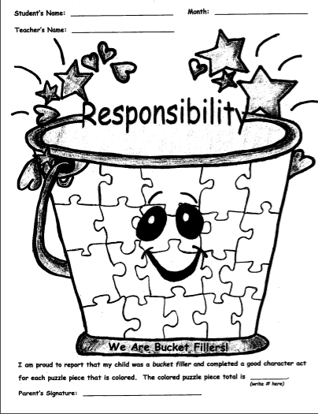
Cubs of Character
Our first bucket puzzle will be due the 24th.
SIGN HERE

Slide 19







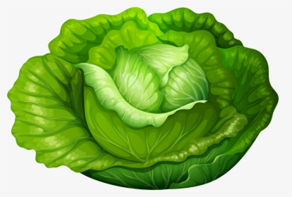

Whitehouse School’s
“Seed to Salad” Program
Parent volunteers are needed to help
make this program a success!!
Sign up today to become a parent volunteer. Grandparents are welcome too.
Students will learn about gardening, soil, and caring for plants through lessons taught by Master Gardeners. This program provides hands on gardening experiences with planting, weed, watering, and of course, harvesting!!

Slide 20

Thank You!
Please always feel free to call or
email with any questions or concerns!
Phone:
(908) 534-4411 Ext. 4119
Email: jricardo@readington.k12.nj.us

Slide 21
Homeroom Parents
Mrs. Fancera
and
Mrs. Molchan

